Slide 1
LINEARIZATION, MODELING AND CONTROL OF A
2D SUBMARINE MODEL
ME5659 Final Project
Mir Munavvar Ali, Logan Buchalter, Savannah Macero, Kevin Shoyer

Slide 2
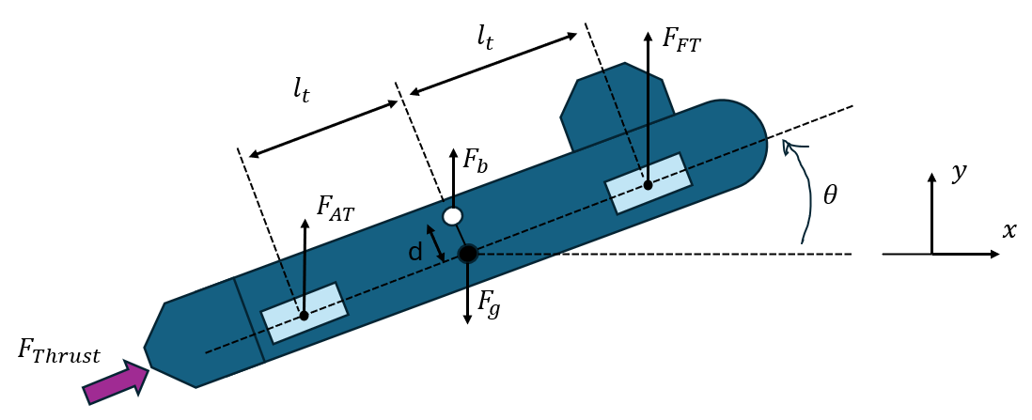
Overview/Background
Submarines must determine position from onboard sensors such as IMU (speed, angle, etc)
Common control methods: PID, LQR, sliding-mode control, nonlinear control
Goal: Control submarine position (x,y) and pose (ϑ) given arbitrary initial conditions
  State Feedback (SS tracking), Observer-based compensator, PID
Methods of control: Differential ballast force (forward and aft), thruster

Slide 3



System Dynamics
Description | Unit | Parameter | Value
Acceleration due to gravity | m/s² | g | 9.81
Submarine mass | kg | m | 10,000
Specific weight of water | N/m³ |  | 9810
Submarine moment of inertia | kg•m³ |  | 40,800
Length from center of submarine to ballast tank | m |  | 3
Volume of forward and aft ballast tanks | m³ | V | 0.62
Fractional ratio of air in forward (FT), aft (AT) tanks |  | P_{FT}, P_{AT} | -0.5 to 0.5
Consolidated drag coefficients in x | kg/m | b_{x} | 615
Consolidated drag coefficients in y | kg/m | b_{y} | 1960
Consolidated drag coefficients in ϑ | kg/m | b_{ϑ} | 10,000
Thrust force | N | F_{thrust}
Ballast force forward (FT), aft (AT) | N | F_{FT}, F_{AT}
Drag force in x, y | N | F_{Dx}, F_{Dy}
Drag torque | N•m | T_{Dϑ}
Position in x,y | m | x, y
Velocity in x,y | m/s | ẋ, ẏ
Acceleration in x,y | m/s² | ẍ, ÿ
Pitch angle | ° | ϑ
Angular velocity | °/s
Angular acceleration | °/s²
Drag force consolidated

Slide 4









Linearizing
Notes:
Define state vector, and put non-linear equation
Define point where we are linearizing about (explain that this was a challenge since there are no equilibrium points)
Show A and B matrix for linear system

Slide 5

Controllability/Observability

Slide 6
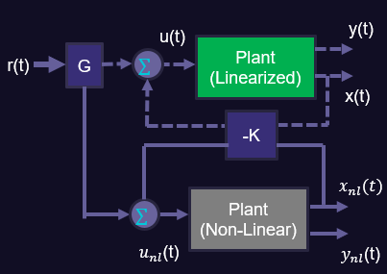

State Space Controller with Steady State Tracking

Slide 7
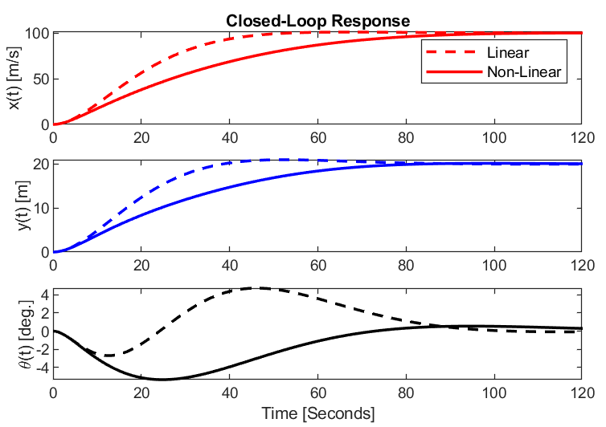
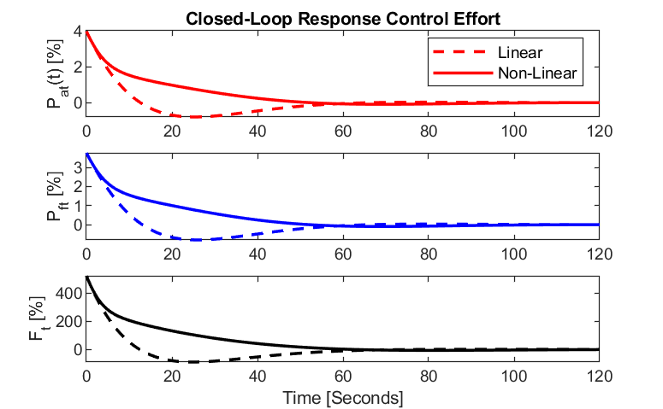
State Space Controller with Steady State Tracking
Desired position: step reference input: r(t) = [100m, 20m, 0 degrees]
Results:
  Linear model matches desired performance
  Non-linear dynamics are slower and more damped due to drag
  Control effort shows controller design/modeling and plant design could be modified for better results

Slide 8

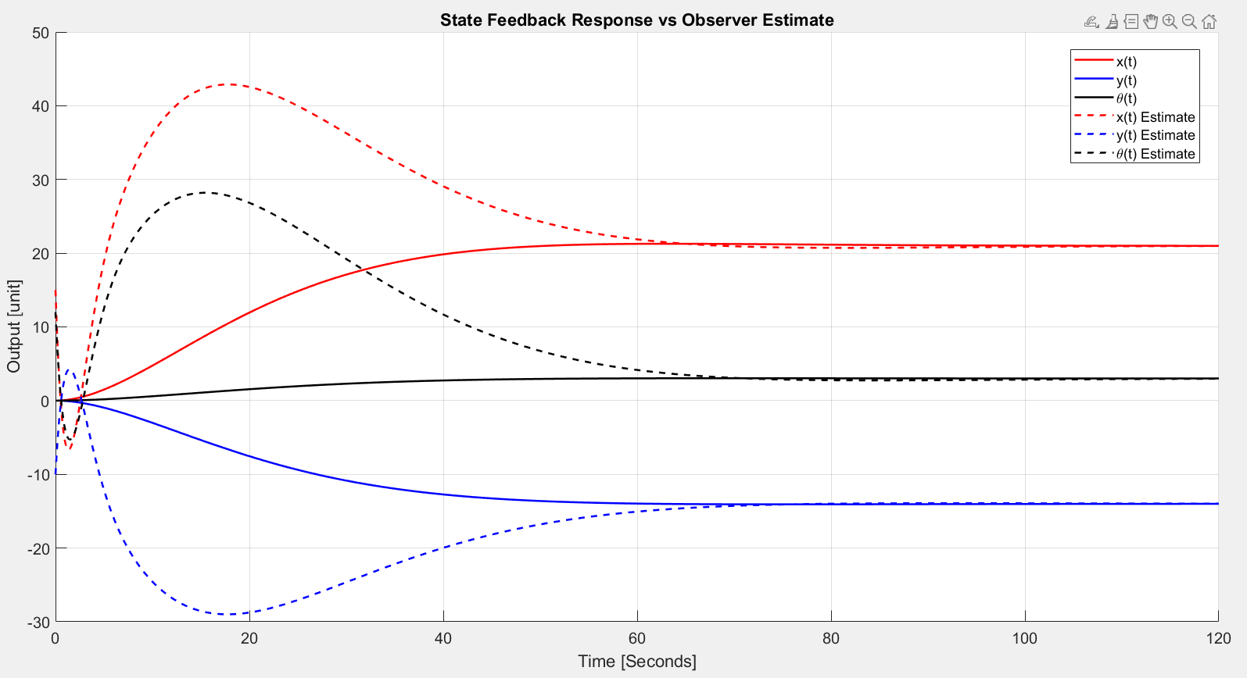
Observer-Based State-Feedback Controller

Slide 9
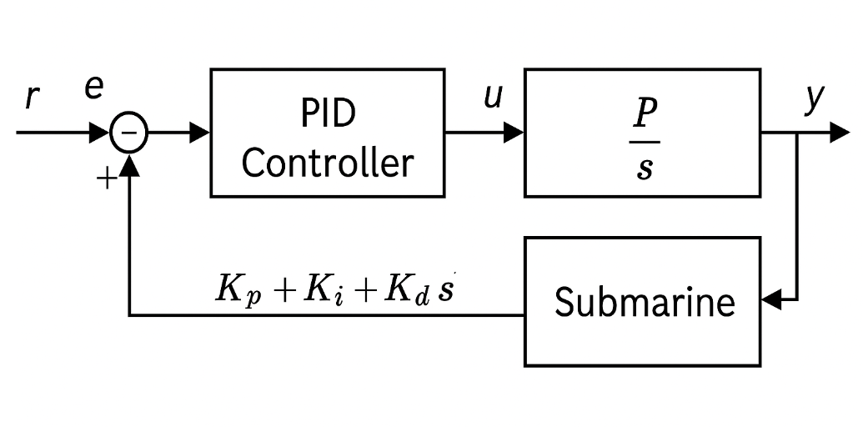
PID controller
Classical PID controller design for linearized 2D model.
Separate PID controllers for each axis using Ziegler–Nichols tuning
Integration with MATLAB's "pidTuner" for gain refinement
Tested with 0 initial conditions, unit step for each axis ([x,y,ϑ])
System and Controller Layout

Slide 10
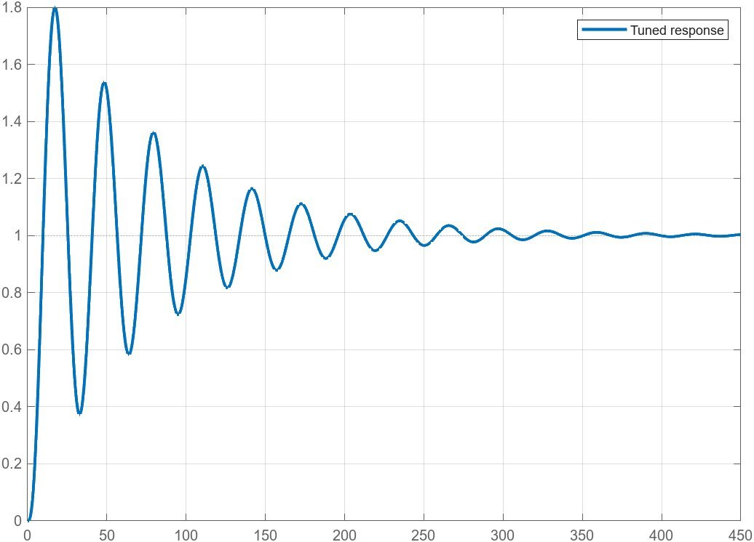
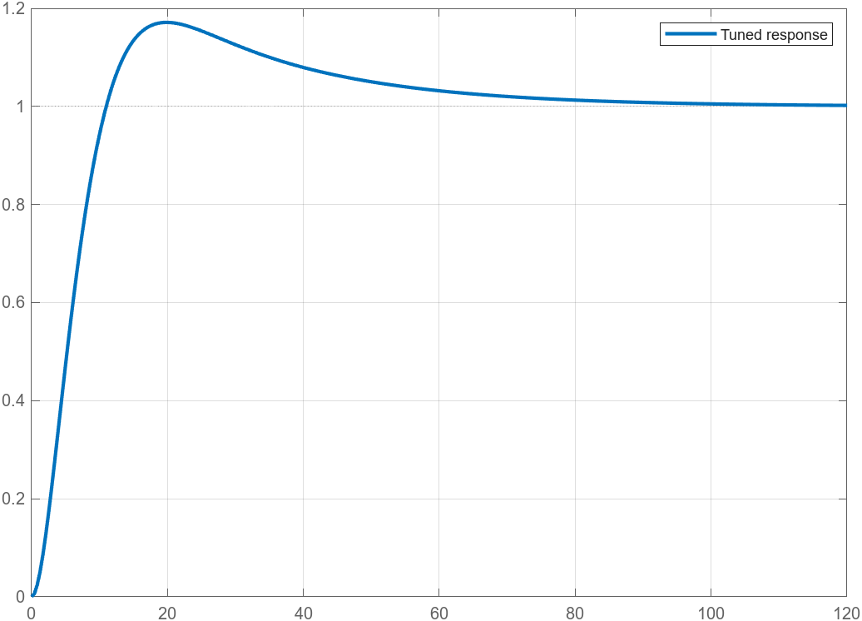
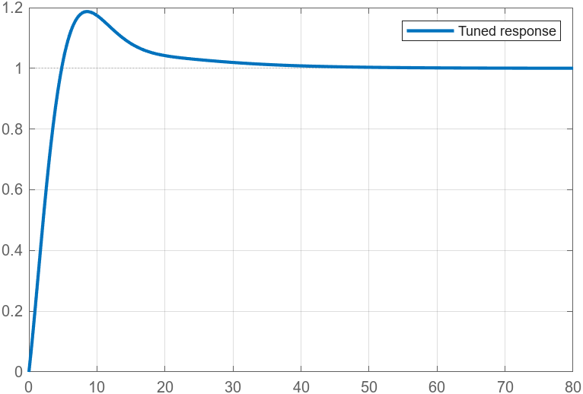
Sample Step Response, Y
Sample Step Response, X
Sample Step Response, ϑ

Slide 11
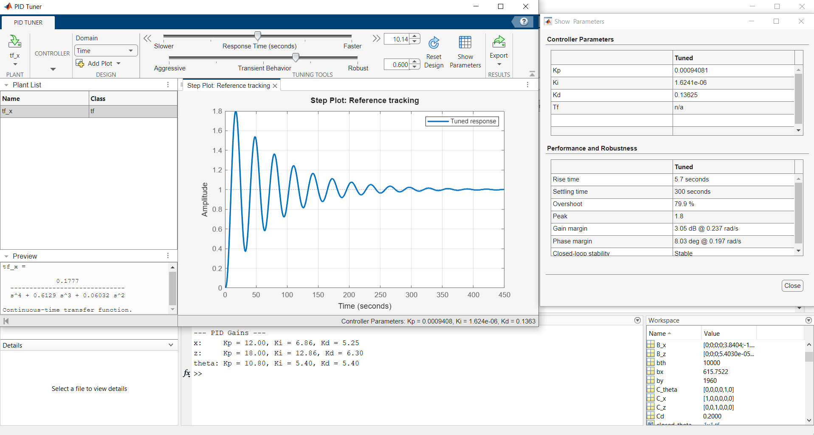
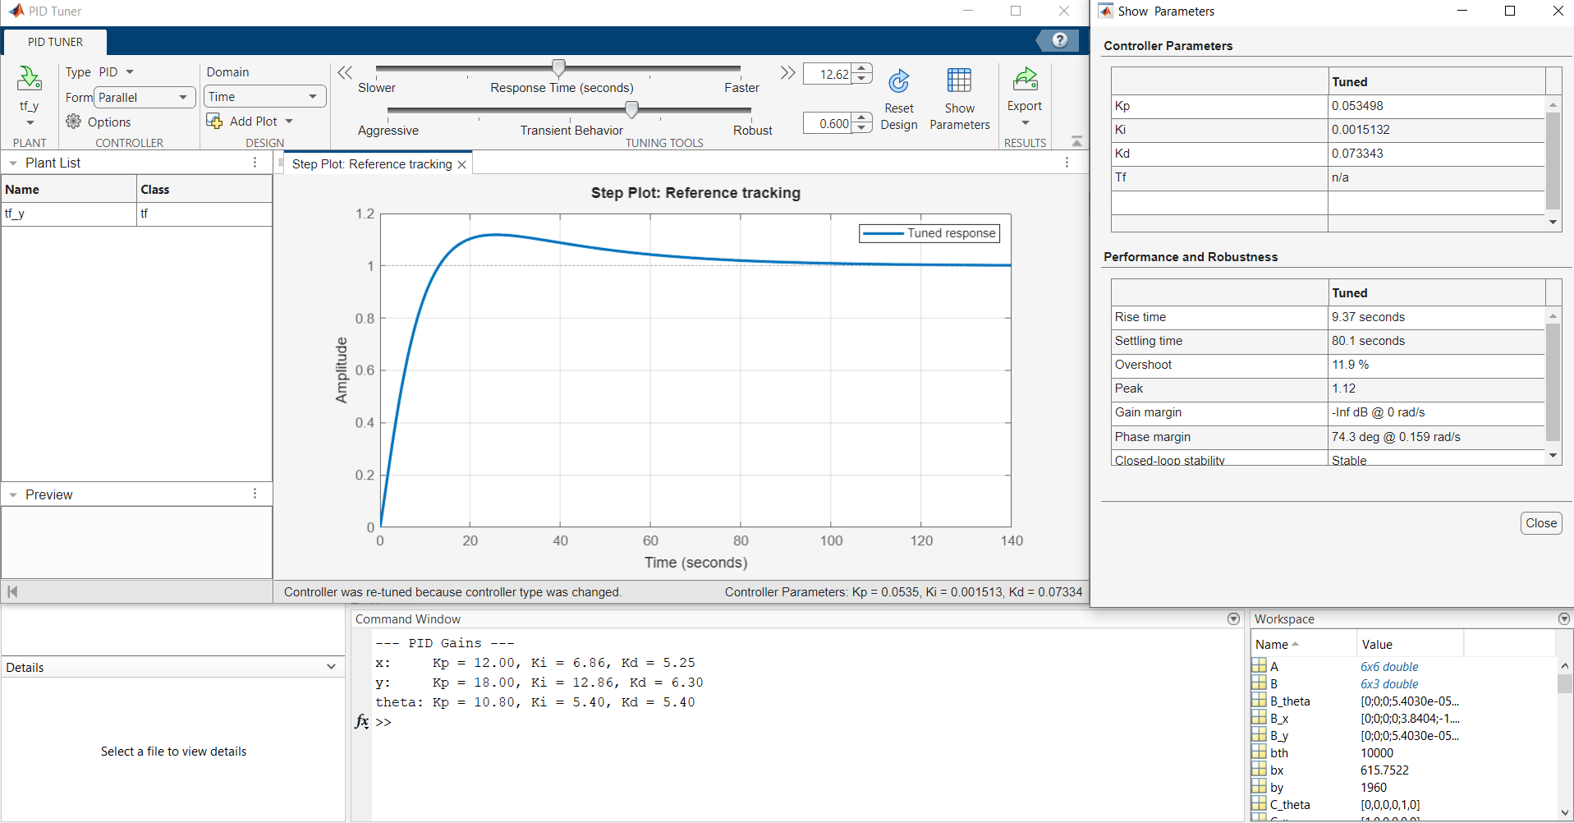
PID CONTROLLER GRAPHICAL DESIGNS :

Slide 12
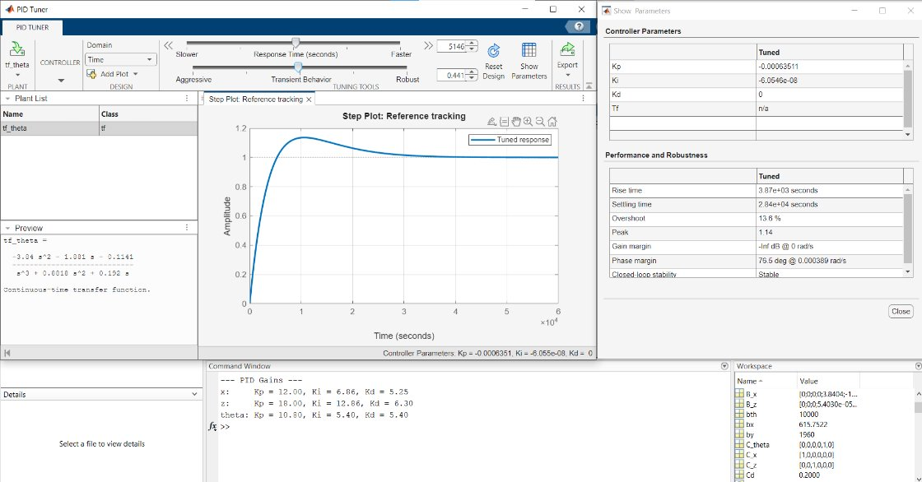
All three PID controllers achieve stable closed-loop behavior. The controllers for x and z exhibit significantly faster dynamics compared to the pitch controller.

Slide 13

State feedback system: Pose from [0,0,0] to [100 -75 -10] (Sped up)

Slide 14

Conclusion

